Slide 1
Fluid Power
By Dr. OMARI MASHI KHALFAN
NIT, MECHANICAL ENGINEERING DEPT.

Slide 2
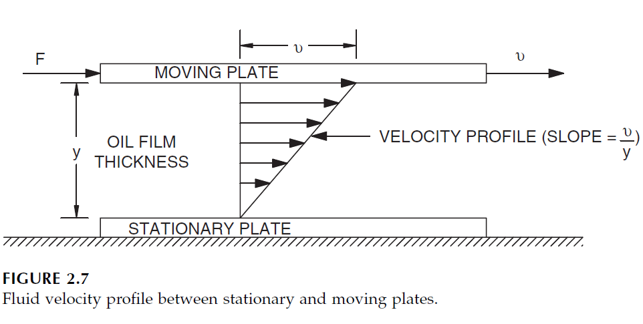
2. FLUID PROPERTIES
2.1 Viscosity: viscosity is a measure of fluid resistance against shear force

Slide 3
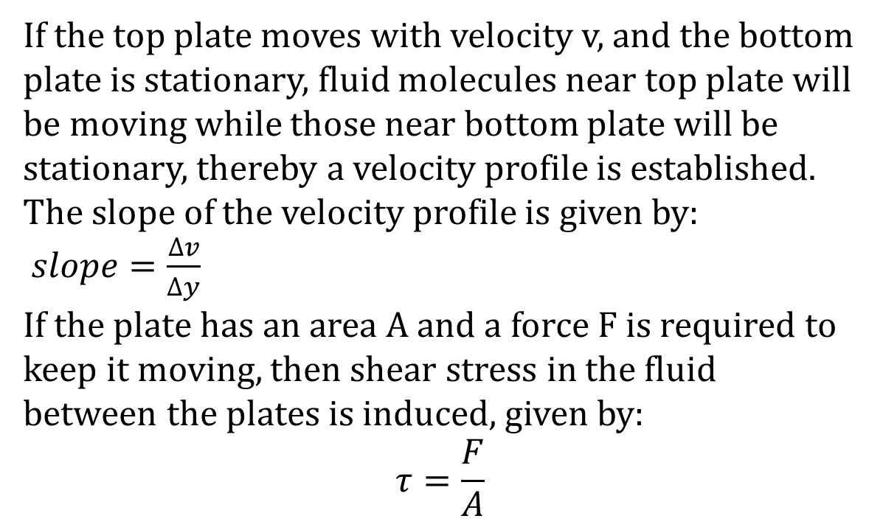
2. FLUID PROPERTIES
If the top plate moves with velocity v, and the bottom plate is stationary, fluid molecules near top plate will be moving while those near bottom plate will be stationary, thereby a velocity profile is established. The slope of the velocity profile is given by:
$slope=\frac{∆v}{∆y}$
If the plate has an area A and a force F is required to keep it moving, then shear stress in the fluid between the plates is induced, given by:
$$τ=\frac{F}{A}$$

Slide 4
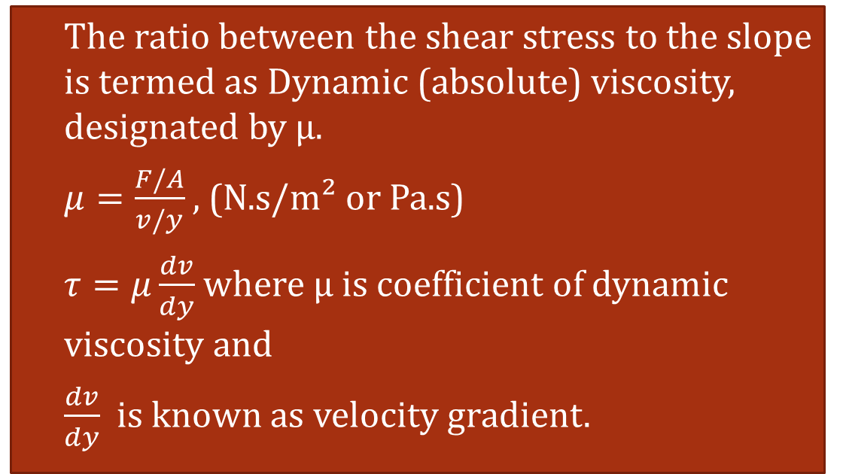
2. FLUID PROPERTIES
The ratio between the shear stress to the slope is termed as Dynamic (absolute) viscosity, designated by μ.
$μ=\frac{F/A}{v/y}$ , (N.s/m² or Pa.s)
$τ=μ\frac{dv}{dy}$ where μ is coefficient of dynamic viscosity and
$\frac{dv}{dy}$ is known as velocity gradient.

Slide 5
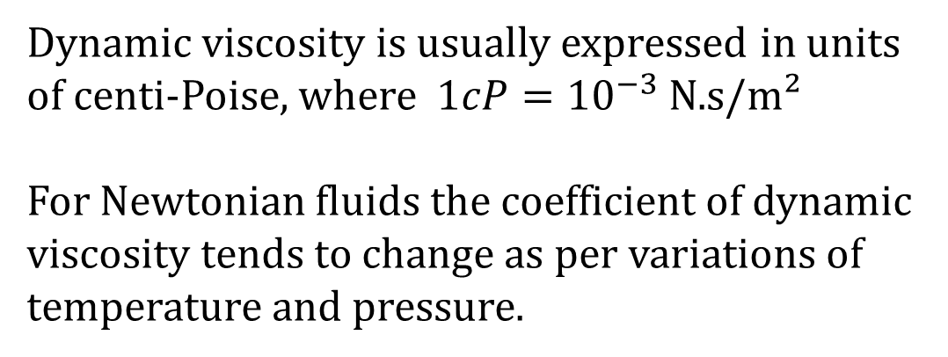
Dynamic viscosity is usually expressed in units of centi-Poise, where $1cP={10}^{−3}$ N.s/m²
For Newtonian fluids the coefficient of dynamic viscosity tends to change as per variations of temperature and pressure.

Slide 6
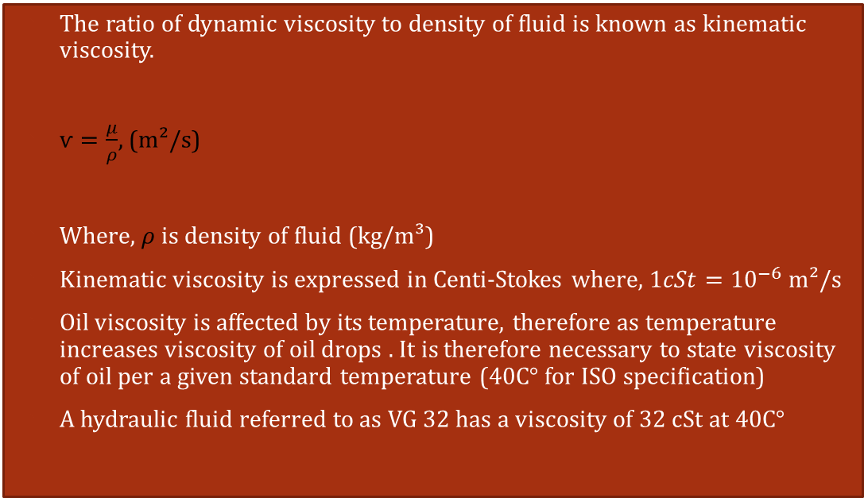
2.2. Kinematic Viscosity, ѵ
The ratio of dynamic viscosity to density of fluid is known as kinematic viscosity.
$ѵ=\frac{μ}{ρ}$, (m²/s)
Where, $ρ$is density of fluid (kg/m³)
Kinematic viscosity is expressed in Centi-Stokes where, $1cSt={10}^{−6}$ m²/s
Oil viscosity is affected by its temperature, therefore as temperature increases viscosity of oil drops . It is therefore necessary to state viscosity of oil per a given standard temperature (40C° for ISO specification)
A hydraulic fluid referred to as VG 32 has a viscosity of 32 cSt at 40C°

Slide 7
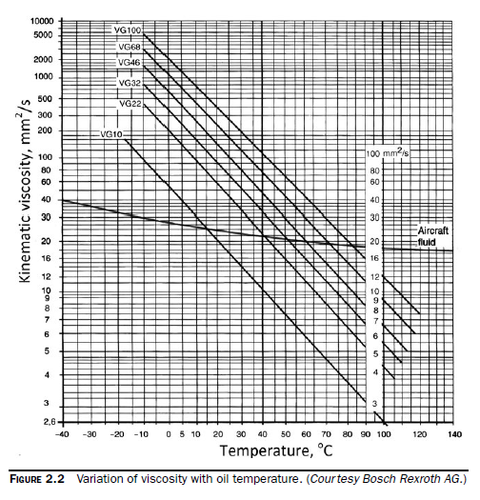
Variation of Kinematic viscosity with Temperature.

Slide 8
2. FLUID PROPERTIES
Oil viscosity should be kept within a certain acceptable range during operation of a fluid power system. Otherwise, system operation will change with temperature.
Viscosity index (VI) is a number used to indicate effect of temperature variation on the viscosity of oil. A low viscosity index means large change of viscosity occurs when temperature changes whereas a high viscosity index means that only minor change in oil viscosity takes place over a wide range of temperatures.

Slide 9
Effects of Viscosity on Hydraulic System Operation
Because viscosity introduces resistance to fluid flow and to the motion of bodies moving in the fluid, the following outcomes are likely to exist:
-Hydraulic losses in transmission lines
-Resistance to fluid flow in narrow conduits
-Viscous friction forces and damping effects

Slide 10
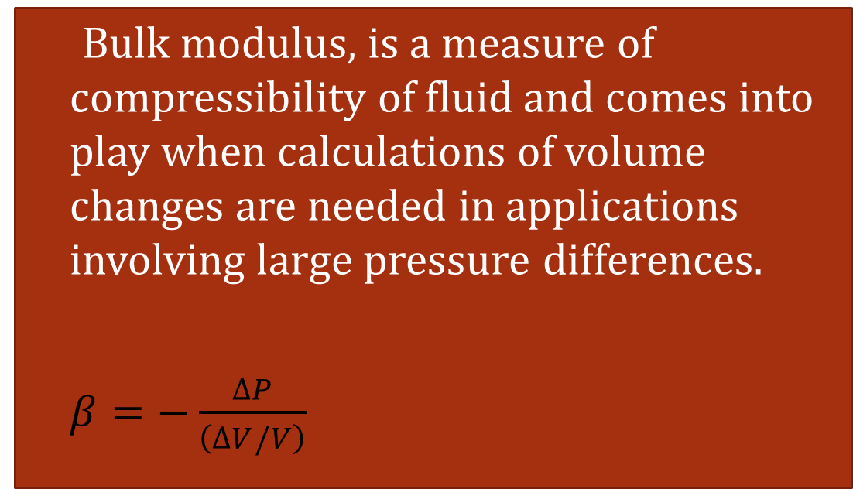
2.3. Bulk Modulus, β
Bulk modulus, is a measure of compressibility of fluid and comes into play when calculations of volume changes are needed in applications involving large pressure differences.
$β=−\frac{∆P}{\left(∆V/V\right)}$

Slide 11
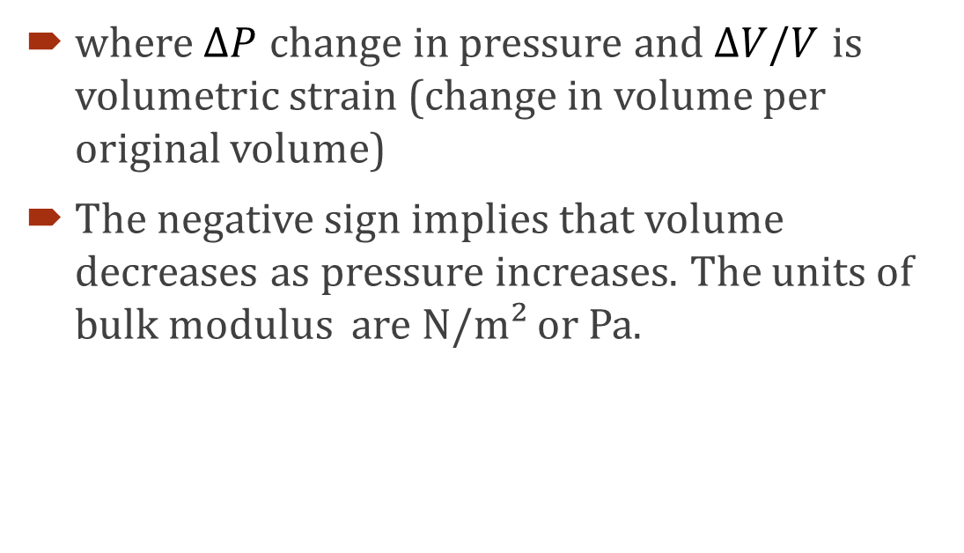
where $∆P$ change in pressure and $∆V/V$ is volumetric strain (change in volume per original volume)
The negative sign implies that volume decreases as pressure increases. The units of bulk modulus are N/m² or Pa.

Slide 12
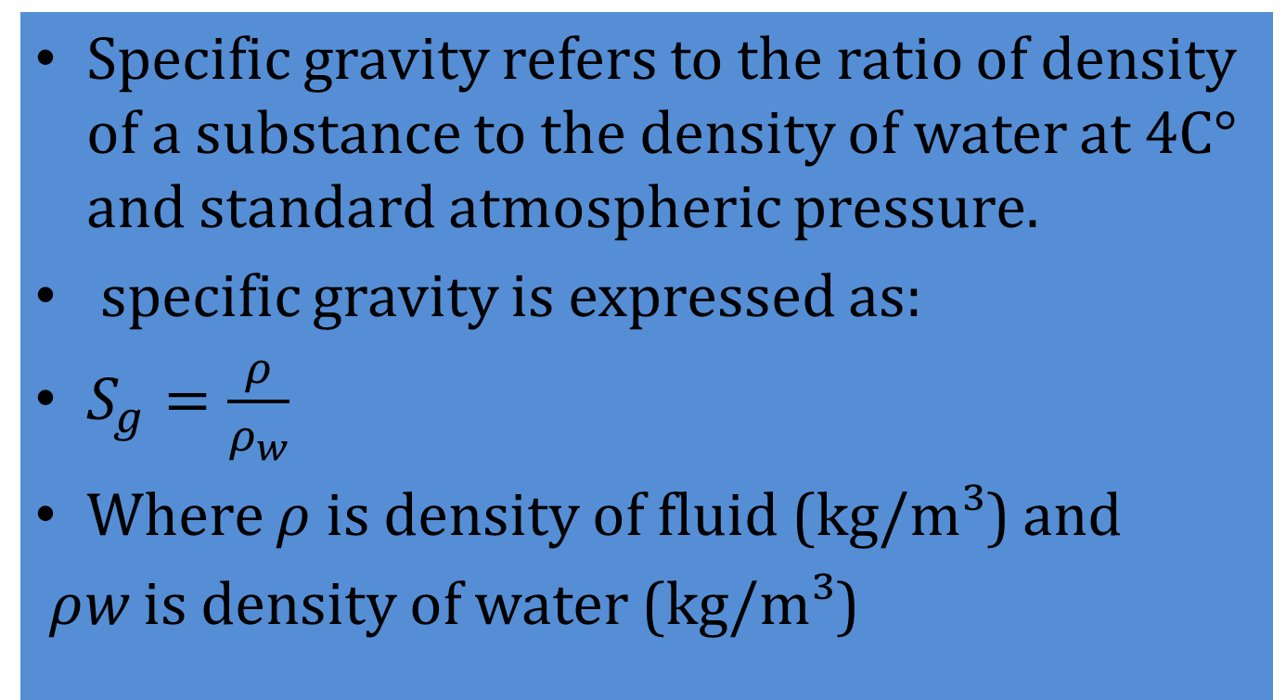
2.4. Specific Gravity, Sg
Specific gravity refers to the ratio of density of a substance to the density of water at 4C° and standard atmospheric pressure.
specific gravity is expressed as:
$S_{g}=\frac{ρ}{ρ_{w}}$
Where $ρ$ is density of fluid (kg/m³) and
$ρ﷮w$ is density of water (kg/m³)

Slide 13
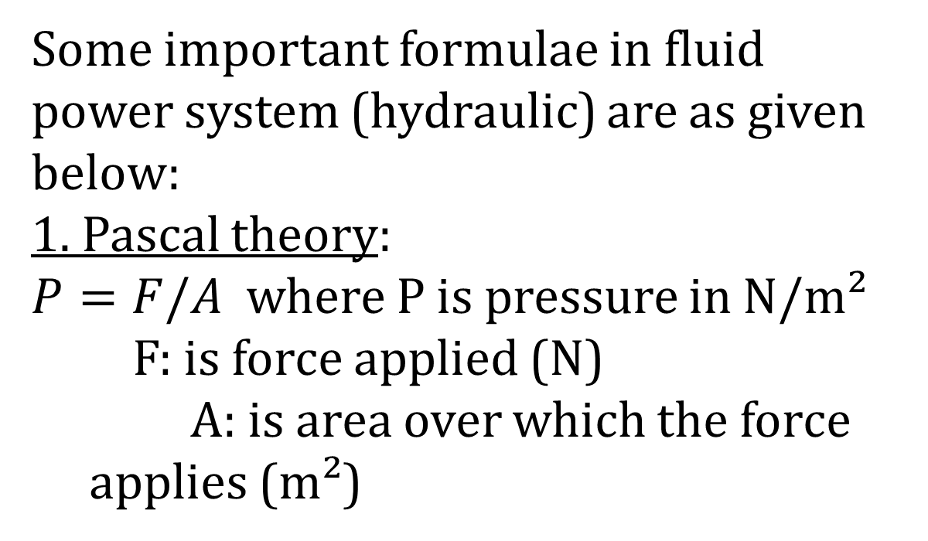
Some important formulae in fluid power system (hydraulic) are as given below:
1. Pascal theory:
$P=F/A$ where P is pressure in N/m²
F: is force applied (N)
A: is area over which the force applies (m²)

Slide 14
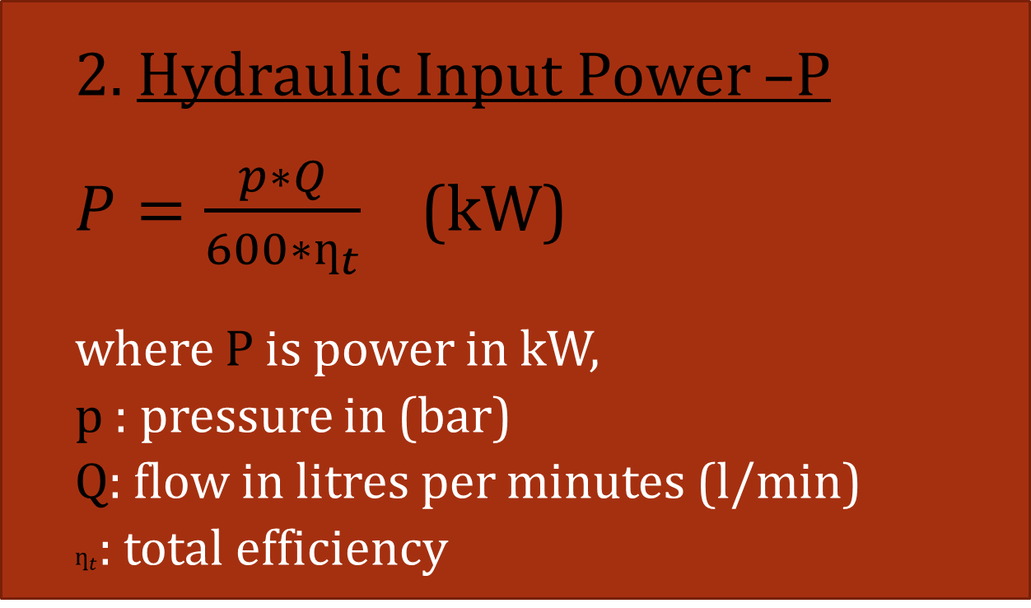
FLUID POWER FORMULAE
2. Hydraulic Input Power –P
$P=\frac{p∗Q}{600∗ƞ_{t}}$ (kW)
where P is power in kW,
p : pressure in (bar)
Q: flow in litres per minutes (l/min)
$ƞ_{t}$: total efficiency

Slide 15
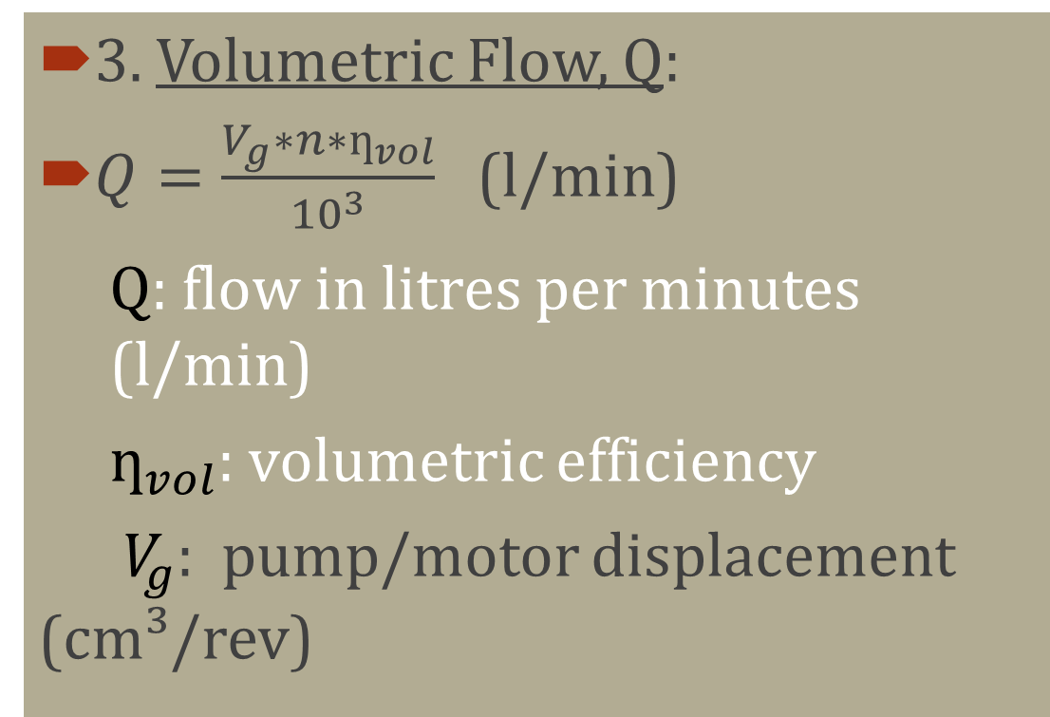
FLUID POWER FORMULAE
3. Volumetric Flow, Q:
$Q=\frac{V_{g}∗n∗ƞ_{vol}}{{10}^{3}}$ (l/min)
Q: flow in litres per minutes (l/min)
$ƞ_{vol}$: volumetric efficiency
${ V}_{g}$: pump/motor displacement (cm³/rev)

Slide 16
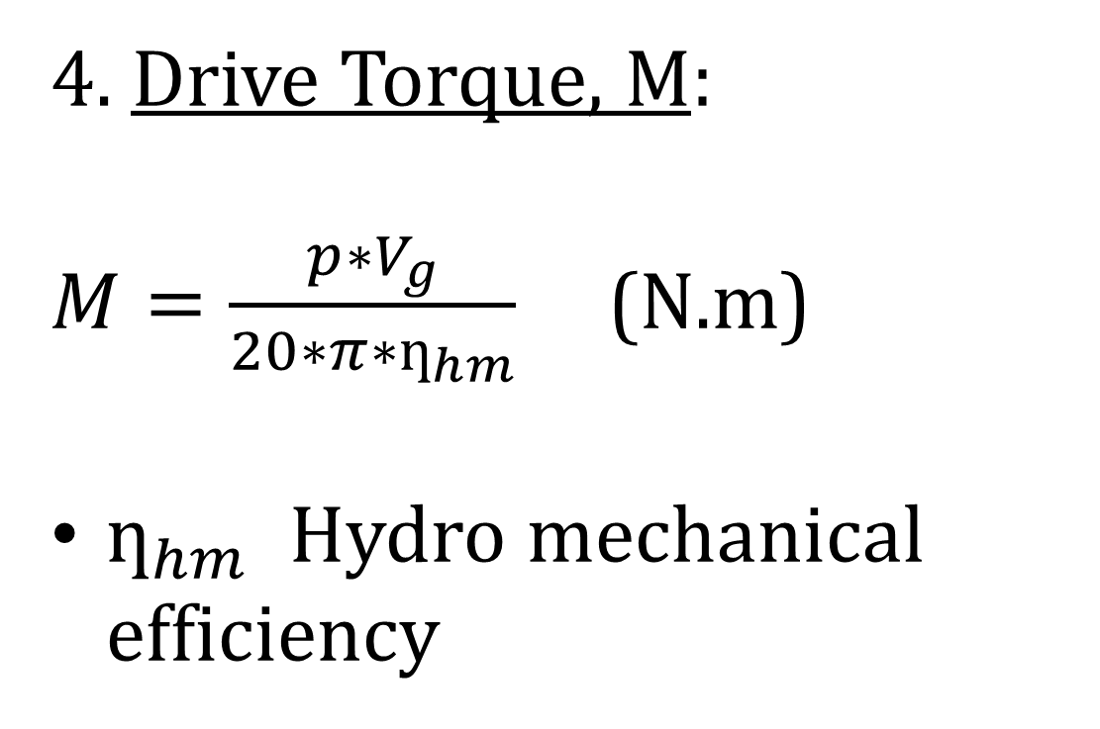
4. Drive Torque, M:
$M=\frac{p∗V_{g}}{20∗π∗ƞ_{hm}}$ (N.m)
$ƞ_{hm}$: Hydro mechanical efficiency mechanical efficiency

Slide 17
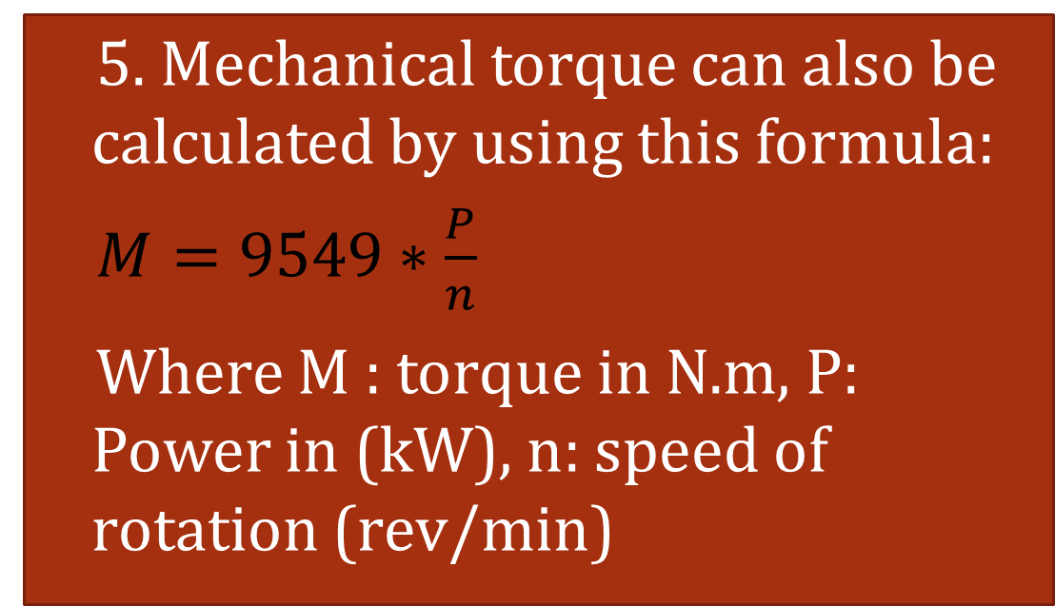
FLUID POWER FORMULAE
5. Mechanical torque can also be calculated by using this formula:
$M=9549∗\frac{P}{n}$
Where M : torque in N.m, P: Power in (kW), n: speed of rotation (rev/min)

Slide 18
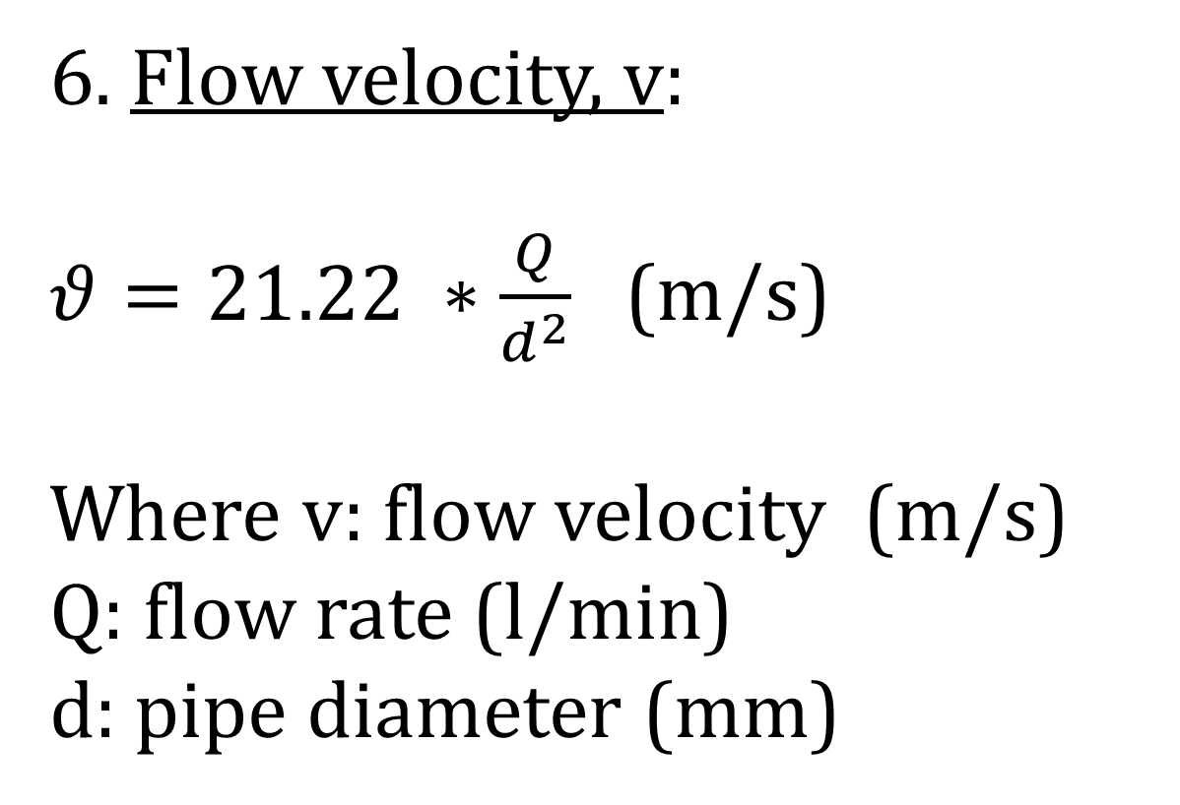
6. Flow velocity, v:
$θ=21.22 ∗\frac{Q}{d^{2}}$ (m/s)
Where v: flow velocity (m/s)
Q: flow rate (l/min)
d: pipe diameter (mm)

Slide 19
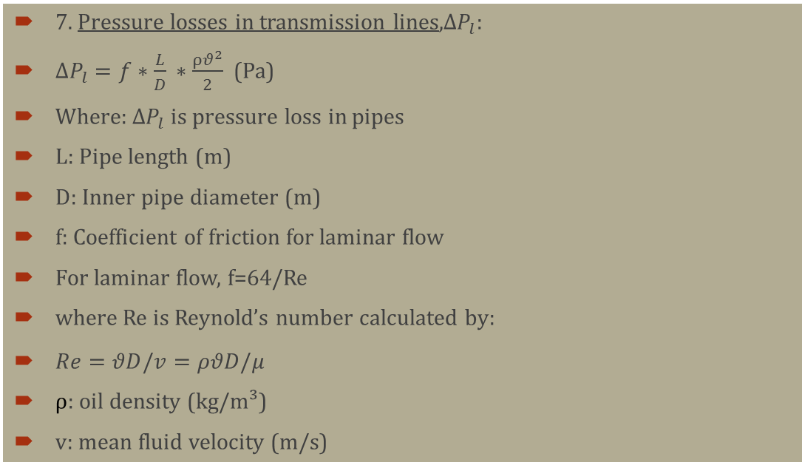
FLUID POWER FORMULAE
7. Pressure losses in transmission lines,$∆P_{l}$:
$∆P_{l}=f∗\frac{L}{D} ∗\frac{ρθ^{2}}{2}$ (Pa)
Where: $∆P_{l}$ is pressure loss in pipes
L: Pipe length (m)
D: Inner pipe diameter (m)
f: Coefficient of friction for laminar flow
For laminar flow, f=64/Re
where Re is Reynold’s number calculated by:
$Re=θD/v=ρθD/μ$
$ρ$: oil density (kg/m³)
v: mean fluid velocity (m/s)

Slide 20
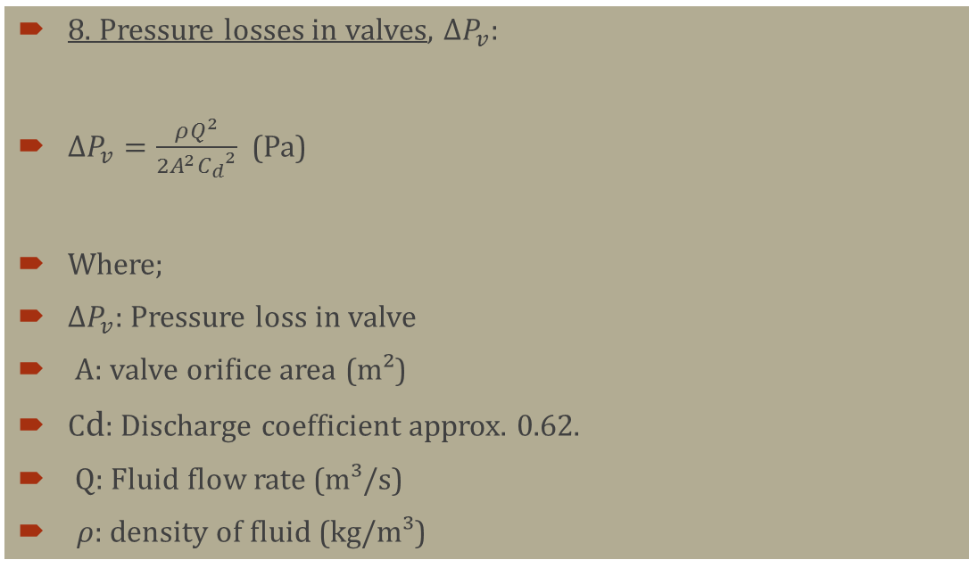
FLUID POWER FORMULAE
8. Pressure losses in valves, $∆P_{v}$:
$∆P_{v}=\frac{ρQ^{2}}{2A^{2}{C_{d}}^{2}}$ (Pa)
Where;
$∆P_{v}$: Pressure loss in valve
A: valve orifice area (m²)
Cd: Discharge coefficient approx. 0.62.
Q: Fluid flow rate (m³/s)
$ρ$: density of fluid (kg/m³)

Slide 21
FLUID POWER COMPONENTS
1. HYDRAULIC PUMP
Pumps in hydraulic systems are used to convert mechanical energy to fluid energy.
There are basically three types of pumps used in hydraulic systems:
i) Gear Pumps-(external, internal and gerotor gear pumps)
ii) Vane Pumps
iii) Piston Pumps

Slide 22
TYPES OF HYDRAULIC PUMPS
Gear Pumps
Gear pumps are low cost types of pumps which always operate as constant (fixed) displacement pumps in hydraulic systems. They are available as external gear, internal gear and gerotor types.
They operate at relatively lower operating pressures as compared to the other types of pumps in the field. This is due to leakage through the gear teeth as operating pressures increase.
Therefore, these types of pumps are used when the operating pressure required for a system is not too high. Typically at a maximum value of 250 Bar.

Slide 23
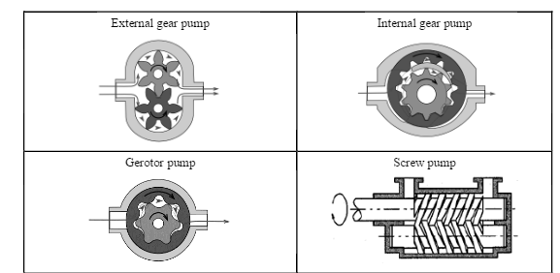
TYPES OF HYDRAULIC PUMPS

Slide 24
VANE PUMPS
Vane pumps are pumps with vanes that slide back and forth in slots. Springs are inserted into the slots to push out the vanes until they contact the cam ring.
Vane pumps are available as both fixed displacement and variable displacement types.
If the cam ring is fixed in position so that a fixed volume is delivered, the vane pump becomes a fixed displacement pump type.

Slide 25
PISTON PUMPS
Piston pumps are pumps whose oil pumping elements are pistons.
These types of pumps are also available as both fixed and variable displacement types.
The pistons are mounted on a swash plate located at an angle. If the swash plate is fixed then the pump becomes fixed displacement whereas a pump with its plate varying is a variable displacement pump.

Slide 26
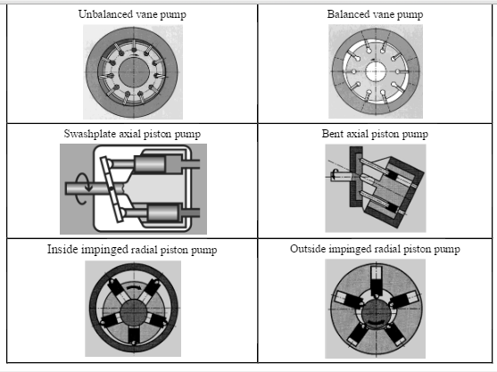
TYPES OF HYDRAULIC PUMPS

